Slide 1
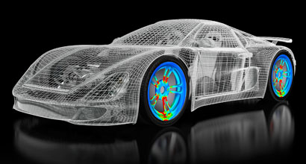
OpenCL
Notes:
The aim of this presentation is to provide an overview of OpenCL, and it’s usage. It will include some examples of when and where to use it. It will also provide some things you need to consider when using OpenCL.

Slide 2



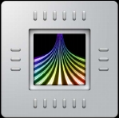
Where Will OpenCL Work?
Intel HD 4000
Intel HD 5000
Notes:
OpenCL was initially developed by Apple Inc., which holds trademark rights, and refined into an initial proposal in collaboration with technical teams at AMD, IBM, Qualcomm, Intel, and Nvidia. Apple submitted this initial proposal to the Khronos Group. On June 16, 2008, the Khronos Compute Working Group was formed with representatives from CPU, GPU, embedded-processor, and software companies. This group worked for five months to finish the technical details of the specification for OpenCL 1.0 by November 18, 2008.
The ratification and release of the OpenCL 2.1 provisional specification was announced on March 3, 2015 at the Game Developer Conference in San Francisco. It was released on November 16, 2015.
AMD, ARM, Intel, and others have declared support for OpenCL 2.1.

Slide 3
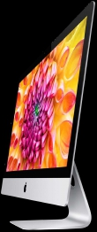

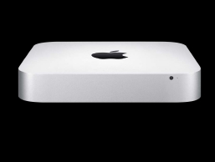
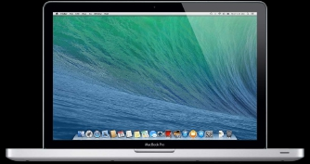
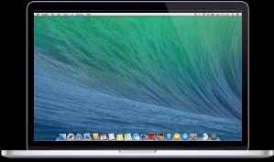
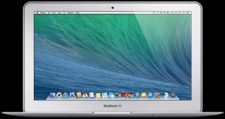
CPU and GPU supported on multiple devices
Notes:
OpenCL consists of a set of headers and a shared object that is loaded at runtime. An installable client driver loader (ICD loader) must be installed on the platform for every class of vendor for which the runtime would need to support. That is, for example, in order to support Nvidia devices on a Linux platform, the Nvidia ICD would need to be installed such that the OpenCL runtime would be able to locate the ICD for the vendor and redirect the calls appropriately. The standard OpenCL header is used by the consumer application; calls to each function are then proxied by the OpenCL runtime to the appropriate driver using the ICD. Each vendor must implement each OpenCL call in their driver.
A number of open source implementations of the OpenCL ICD exist, including freeocl and ocl-icd.
CPU-only version building on Clang and LLVM, called pocl, is intended to be a portable OpenCL implementation.
A key feature of OpenCL is portability, via its abstracted memory and execution model, and the programmer is not able to directly use hardware-specific technologies such as inline Parallel Thread Execution (PTX) for Nvidia GPUs unless they are willing to give up direct portability on other platforms. It is possible to run any OpenCL kernel on any conformant implementation.
However, performance of the kernel is not necessarily portable across platforms. Existing implementations have been shown to be competitive when kernel code is properly tuned, though, and auto-tuning has been suggested as a solution to the performance portability problem, yielding "acceptable levels of performance" in experimental linear algebra kernels. Portability of an entire application containing multiple kernels with differing behaviors was also studied, and shows that portability only required limited tradeoffs.
A study at Delft University that compared CUDA programs and their straightforward translation into OpenCL C found CUDA to outperform OpenCL by at most 30% on the Nvidia implementation. The researchers noted that their comparison could be made fairer by applying manual optimizations to the OpenCL programs, in which case there was "no reason for OpenCL to obtain worse performance than CUDA". The performance differences could mostly be attributed to differences in the programming model (especially the memory model) and to NVIDIA's compiler optimizations for CUDA compared to those for OpenCL.
Another study at D-Wave Systems Inc. found that "The OpenCL kernel’s performance is between about 13% and 63% slower, and the end-to-end time is between about 16% and 67% slower" than CUDA's performance.
The fact that OpenCL allows workloads to be shared by CPU and GPU, executing the same programs, means that programmers can exploit both by dividing work among the devices.^{[93]} This leads to the problem of deciding how to partition the work, because the relative speeds of operations differ among the devices. Machine learning has been suggested to solve this problem: Grewe and O'Boyle describe a system of support vector machines trained on compile-time features of program that can decide the device partitioning problem statically, without actually running the programs to measure their performance.
Some vendors provide extended functionality over the standard OpenCL specification via the means of extensions. These are still specified by Khronos but provided by vendors within their SDKs. They often contain features that are to be implemented in the future – for example device fission functionality was originally an extension but is now provided as part of the 1.2 specification.
Extensions provided in the 1.2 specification include:
Writing to 3D image memory objects
Half-precision floating-point format
Sharing memory objects with OpenGL
Creating event objects from GL sync objects
Sharing memory objects with Direct3D 10
DX9 media Surface Sharing
Sharing Memory Objects with Direct3D 11
Device fission – introduced fully into the OpenCL standard with version 1.2 – allows individual command queues to be used for specific areas of a device. For example, within the Intel SDK, a command queue can be created that maps directly to an individual core. AMD also provides functionality for device fission, also originally as an extension. Device fission can be used where the availability of compute is required reliably, such as in a latency sensitive environment. Fission effectively reserves areas of the device for computation.

Slide 4
Overview:
Open, royalty-free standard for heterogeneous (and homogeneous) parallel computing with support for a diversity of applications and hardware
Unified programming model for all CPU, GPU, Cell, DSP, FPGA and other processors in a system
Notes:
Open, royalty-free standard for heterogeneous (and homogeneous) parallel computing
Unified programming model for all CPU, GPU, Cell, DSP, FPGA and other processors in a system
Requires vendors to provide open standards and/or drivers so devices can be used
Cross-vendor software portability to a wide range of silicon and systems
HPC servers, desktop systems and handheld devices covered in one specification
Any developer can freely use OpenCL with no royalties
Support for a wide diversity of applications
From embedded and mobile software through consumer applications to HPC solutions
Not locked into one platform (can move from GPU to FPGA)
Create a foundation layer for a parallel computing ecosystem
Close-to-the-metal interface to support a rich diversity of middleware and applications
OpenCL implementations must pass conformance tests to use trademark (analogous to OpenGL)
Some performance hit due to cross platform compatibility Enable use of all computational resources in a system
Program GPUs, CPUs, Cell, DSP and other processors as peers
Support both data- and task- parallel compute models
Efficient C-based parallel programming model
Familiar language for rapid adoption
Other bindings now available (Java, Ruby, C++, etc)
Close integration with OpenGL and other 3D APIs
For advanced visualization application and innovation
Enable embedded and handheld devices
Through an embedded profile in the specification
Language Specification
C-based cross-platform programming interface
Subset of ISO C99 with language extensions - familiar to developers
Well-defined numerical accuracy - IEEE 754 rounding behavior with defined maximum error
Double precision optional
Online or offline compilation and build of compute kernel executables
Includes a rich set of built-in functions
OpenCL 1.0:
Initially developed by Apple
Refined into a proposal in collaboration with AMD, IBM, Intel and Nvidia and presented to Khronos Group
OpenCL 1.1:
Ratified by Khronos Group
Additional capability added
OpenCL 1.2:
Device partitioning
Built in kernels for custom devices with unique capability
Functionality to compile OpenCL into external libraries

Slide 5


Differentiation:
OpenGL is for graphics,
OpenCL for compute,
Can be used together
Notes:
Although OpenGL is targeted at graphics and OpenCL is used for compute, they can be, and are often used together. For example OpenCL can be used for image processing and then OpenGL can be used for the display of the results.

Slide 6
Terminology:
Hosts, Devices, Compute units,
Contexts, Command queues, Program objects,
Kernel functions, Kernel objects, Memory objects
Notes:
All applications make use of the same set of elements:
Hosts
Devices
Compute units
Contexts
Command queues
Program objects
Kernel functions
Kernel objects
Memory objects

Slide 7
Hosts:
The program that calls the OpenCL functions to set up the context in which the kernels run and enqueue the kernels for execution is known as the host application
The device on which the host application executes is know as the host device
Notes:
The program that calls the OpenCL functions to set up the context in which the kernels run and enqueue the kernels for execution is known as the host application
The device on which the host application executes is know as the host device
Before the kernels can be run the host application must complete the following steps (some sample code later):
Determine what compute devices are available
Select the compute devices appropriate to the application
Create command queues for the selected compute devices
Allocate the memory objects needed by the kernels for execution
The host device itself can be an OpenCL device (eg CPU)

Slide 8
Devices:
Refers to any computational device on a computer system as a device (GPUs, CPUs, etc)
Within each device there are one or more units referred to as compute units (cores, ALUs, etc)
Notes:
Specification:
Refers to any computational device on a computer system as a device (GPUs, CPUs, etc)
Within each device there are one or more units referred to as compute units (cores, ALUs, etc)
Generally the number of compute units corresponds to the number of independent instructions that a device can execute at the same time

Slide 9
Kernels:
When you write a set of instructions in the OpenCL C language intended for compilation and execution on a device you’re creating an OpenCL kernel (also called a kernel function of a compute kernel)
Notes:
When you write a set of instructions in the OpenCL C language intended for compilation and execution on a device you’re creating an OpenCL kernel (also called a kernel function of a compute kernel)
A kernel is essentially a function written in a language that enables it to be compiled for execution on any device that supports OpenCL
Although kernels are enqueued for execution by host applications, a kernel must be compiled separately in order to be customised for the device
Kernels can be compiled at runtime when launching the host application (online), or you can use a previously built binary (offline)
There can be more than one kernel

Slide 10
Kernel Objects, Programs, and Contexts:
A kernel object encapsulates a specific kernel declared in the program
An OpenCL program is a set of OpenCL kernels, auxillary functions called by the kernels, and constants used by the kernels
The context is the environment in which the OpenCL kernels execute
Notes:
A kernel object encapsulates a specific kernel declared in the program
An OpenCL program is a set of OpenCL kernels, auxillary functions called by the kernels, and constants used by the kernels
The context is the environment in which the OpenCL kernels execute
A context includes a set of devices, the memory accessible to those devices and one or more command queues used to schedule execution on on one or more kernels
A context is needed to share memory between devices

Slide 11
Program Objects and Command Queues:
An OpenCL program object is the data type that represents your OpenCL program
OpenCL command queues are used for submitting work to a device
Notes:
An OpenCL program object is the data type that represents your OpenCL program.
It encapsulates the following data:
A reference to a context for the program (which is need to know on which devices the program can run)
The program source code of binary
The latest successfully built OpenCL executable
The list of devices for which the program executable was built, the build options used, build log, etc
OpenCL command queues are used for submitting work to a device
Order the execution of kernels on a device and manipulate memory objects
OpenCL executes the commands in the order that you enqueue them

Slide 12
Memory Objects:
Buffer objects which can contain any type of data and,
Image objects which are specifically for representing images
Notes:
A memory object is a handle to a region of global memory
You can create memory objects to reserve memory on a device to store your application data
There are two type of memory objects used in OpenCL:
Buffer objects which can contain any type of data and,
Image objects which are specifically for representing images
The host application can enqueue commands to read from and write to memory objects
Need to be aware of memory concurrency and consistency when doing memory operations in parallel (no consistency across work groups)
Need to be aware of task versus data parallelism

Slide 13
Operational Model:
Platform model
Execution model
Memory model
Programming model

Slide 14
Platform Model:
A high-level representation of the heterogeneous system
Need to keep the architecture in mind when optimising parallel programming
Notes:
A high-level representation of the heterogeneous system
The OpenCL device communicates with the host device (the device on which the controlling application is running)
Normally, the throughputs of the compute device’s internal busses are much faster than the throughput of the external bus between the compute device and the host
Because the data transfer takes a long time, you need to do enough computations in each kernel to make sure you are not limited by this latency
Need to keep the architecture in mind when optimising parallel programming

Slide 15
Execution Model:
An abstract representation of how streams of instructions execute
Execution of an OpenCL program involves simultaneous execution of multiple instances of a kernel on one or more OpenCL devices as queued and controlled by the host application
Notes:
An abstract representation of how streams of instructions execute
Execution of an OpenCL program involves simultaneous execution of multiple instances of a kernel on one or more OpenCL devices as queued and controlled by the host application
Each instance of a kernel is known as a work-item
Each work-item executes the same code, but on different parts of the data
Each work-item runs on a single core of a multiprocessor
When you submit a kernel to execute on a device, you define the number of work-items that you need to completely process all of your data (this is known as the index space)
Work-items can be organized into work-groups
OpenCl supports synchronization of computation between work-items in a work-group using barriers and memory fences, but does not permit such synchronization between different work-groups or work-items in separate work-groups
In order to generalize your OpenCL application to run on a variety of hardware, you should not hard-code into your program the number of work-items and work-groups to be used
This number changes based on the device and kernel
You can use the OpenCL API to query the OpenCL runtime about its status and find out when your kernel has finished executing
Use the clGetDeviceInfo with the selector CL_DEVICE_MAX_WORK_ITEM_SIZES and the clGetKernelWorkgroupInfo function with the selector CL_KERNEL_WORK_GROUP_SIZE to determine the maximum work-group size for a given device and kernel
The host application sets up the context in which the kernels run, including allocation of memory of various types, transfer of data among memory objects, and creation of command queues used to control the sequence in which commands (including the commands that execute kernels) are run
You are responsible for synchronizing any necessary order of execution (OpenCL API includes synchronization commands for this purpose)

Slide 16
Memory Model:
Global Memory
Constant Memory
Local Memory
Private Memory
Notes:
OpenCL generalizes the different types of memory available:
Global memory is available for reading and writing by all work-items in all work-groups (it is the device memory in the platform model)
Constant memory is a region of global memory that is reserved for read-only access by work-items and is held constant during the execution of a kernel (it can be written and read by the host application)
Local memory is available for reading and writing by a specific work-group and can be used to hold values that are shared by all work-items in a work-group
Private memory is available to only a single work-item
When writing kernels in the OpenCL language, you must declare your memory with certain address space qualifiers to indicate whether the data resides in global, constant, local, or private memory, or it will default to private within a kernel
This becomes particularly important in the case of parallel programing

Slide 17
Use Cases and Examples
Notes:
In this section we’ll look at some simple use cases and examples. This will help give you an idea about some of the applications of OpenCL and some of the considerations that need to be taken into account when using OpenCL.

Slide 18

Am I waiting for something?
Notes:
Before we look at parallelism. Where OpenCL has obvious uses due to GPUs having lots of discrete ALUs, or ASICs having dedicated functions that are are not implemented in general CPUs. Can we make use of OpenCL to offload task to GPUs or other devices, that would free up the main CPU for other tasks. This could include encoding / decoding, and encryption / decryption. If the time taken to farm these tasks off and get them back is less than the time it takes on the main CPU, or would allow the CPU to do other work while it waits for the results then OpenCL can be of use.

Slide 19


Am I waiting for something?
Have I avoided something intensive?
Notes:
Some mathematic functions due to their complexity are better done on dedicated devices such as GPUs. Doing them on CPUs takes longer as general CPUs are designed to do a large number of generic functions. There are economies of scale associated with silicon. The more functions required the more space required,

Slide 20

Am I waiting for something?
Have I avoided something intensive?
Notes:
If we can offload functions to save time, either by running them faster on a dedicated device, or by freeing up the main CPU to do other tasks then it’s worth taking advantage of OpenCL. Is it really worth doing this? GPUs can do some dedicate math functions over 100 times faster than a standard CPU.

Slide 21



Am I waiting for something?
Have I avoided something intensive?
Do I have a parallel workload?
Notes:
Next we consider parallel workloads. If we have lots of data that can be split up or operated on in parallel where there are no or few dependancies them we can exploit parallelism to speed up our jobs. Often due to the size of memory and capability of the ALUs on GPUs, you will need to split up the job in order to be able to utilise the GPUs effectively.

Slide 22
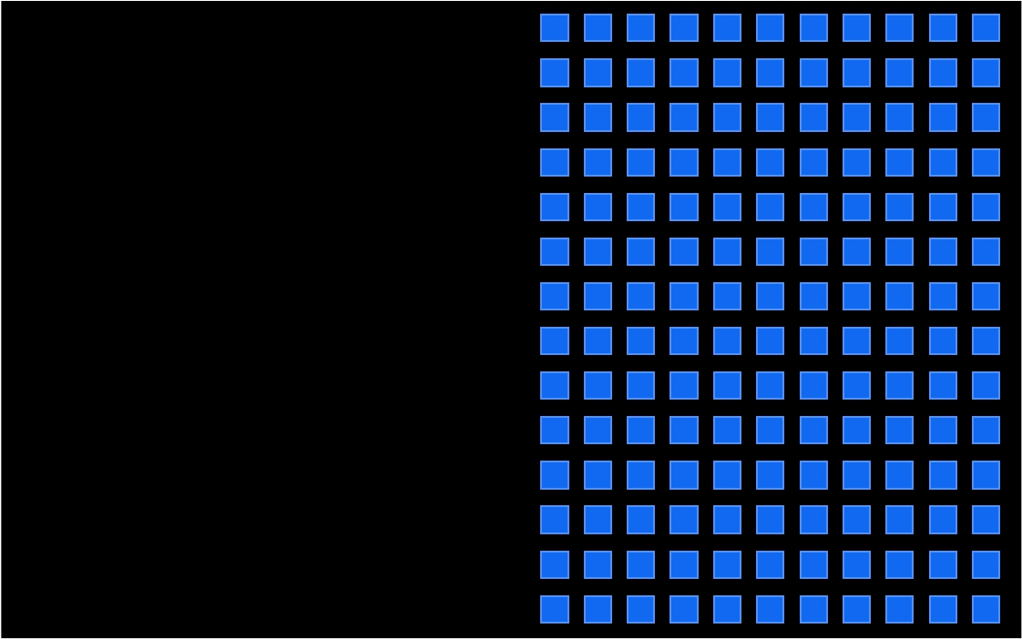
pieces of data
Notes:
What about if we have pieces of data… You can also think of these pieces of data as analogous to the ALUs on the GPUs. Each piece of data will be processed by an ALU.

Slide 23
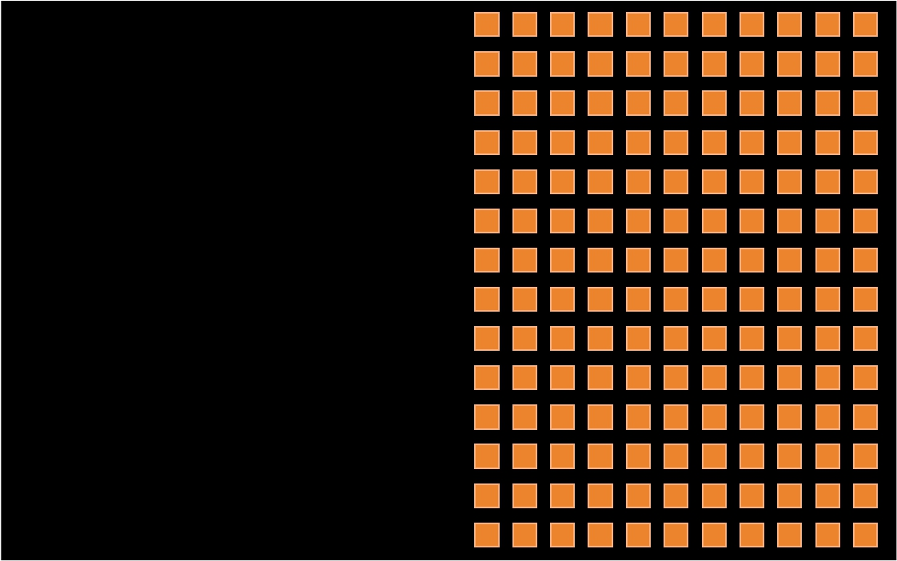
pieces of data
all changing in the same way
Notes:
That we want to change in the same way…

Slide 24
pieces of data
all changing in the same way
few dependencies
Notes:
And there are few dependances… Sounds a like pixels in an image doesn’t it.

Slide 25
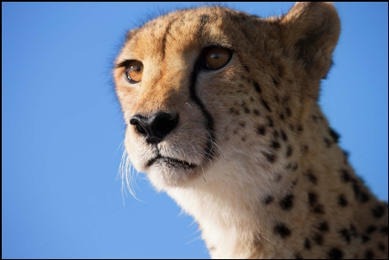
Notes:
Image processing operations are suited well to GPUs and thus OpenCL.

Slide 26
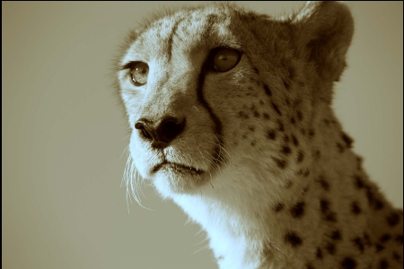
Notes:
For example we can run a image filter on an image using OpenCL. In this kind of function we perform the same, but admittedly simple operation to a lot of pixels. This is particularly suited to GPUs with lots of ALUs where it can be done in parallel rather than a CPU where there a limited number of cores and thus a limited level of parallelism.

Slide 27

Notes:
A more complex example is something like a Fourier Transform of an image. The Fourier Transform is an important image processing tool which is used to decompose an image into its sine and cosine components. The output of the transformation represents the image in the Fourier or frequency domain, while the input image is the spatial domain equivalent. In the Fourier domain image, each point represents a particular frequency contained in the spatial domain image. The Fourier Transform is used in a wide range of applications, such as image analysis, image filtering, image reconstruction and image compression. GPUs are faster than CPUs at doing these kind of operations.

Slide 28
Am I waiting for something?
Have I avoided something intensive?
Do I have a parallel workload?
Notes:
From the previous examples we’ve seen how we can offload work to more suitable units, or perform simple parallel operations. These are good uses for OpenCL.

Slide 29



Am I waiting for something?
Have I avoided something intensive?
Do I have a parallel workload?
Can I earn a parallel workload?
Notes:
How about where we don’t have a parallel workload, or a parallel workload doesn’t give us much of an advantage. Can we earn a parallel workload.

Slide 30
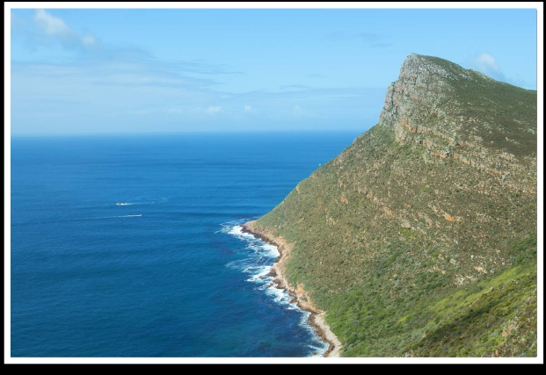
Notes:
Let’s have a look at a simple example, a histogram of a picture.
An image histogram is a type of histogram that acts as a graphical representation of the tonal distribution in a digital image. It plots the number of pixels for each tonal value. By looking at the histogram for a specific image a viewer will be able to judge the entire tonal distribution at a glance.
Image histograms are present on many modern digital cameras. Photographers can use them as an aid to show the distribution of tones captured, and whether image detail has been lost to blown-out highlights or blacked-out shadows. This is less useful when using a raw image format, as the dynamic range of the displayed image may only be an approximation to that in the raw file.
In the field of computer vision, image histograms can be useful tools for thresholding. Because the information contained in the graph is a representation of pixel distribution as a function of tonal variation, image histograms can be analyzed for peaks and/or valleys. This threshold value can then be used for edge detection, image segmentation, and co-occurrence matrices.

Slide 31
0
255
Red Histogram
0
255
Green Histogram
0
255
Blue Histogram
Notes:
The horizontal axis of the graph represents the tonal variations, while the vertical axis represents the number of pixels in that particular tone.
The left side of the horizontal axis represents the black and dark areas, the middle represents medium grey and the right hand side represents light and pure white areas. The vertical axis represents the size of the area that is captured in each one of these zones. Thus, the histogram for a very dark image will have the majority of its data points on the left side and center of the graph. Conversely, the histogram for a very bright image with few dark areas and/or shadows will have most of its data points on the right side and center of the graph.

Slide 32

0
255
Red Histogram
0
255
Green Histogram
0
255
Blue Histogram
Notes:
Histograms are an important data representation with many applications in computer vision, data analytics and medical imaging

Slide 33
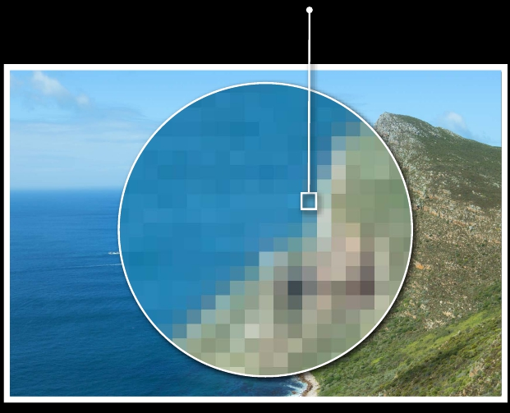
Red
Green
Blue
79
148
186
0
255
Red Histogram
0
255
Green Histogram
0
255
Blue Histogram
Notes:
Even with modern CPUs with a number off cores processing large images can take time and is not very parallel in nature, if parallel at all.

Slide 34
Red
Green
Blue
79
148
186
+1
0
255
Red Histogram
+1
0
255
Green Histogram
+1
0
255
Blue Histogram
Notes:
In fact it can be quite slow compared to a GPU.

Slide 35



0
255
Red Histogram
0
255
Green Histogram
0
255
Blue Histogram
Notes:
On the face of things this might seem fine, providing you are willing to wait.

Slide 36
0
255
Red Histogram
0
255
Green Histogram
0
255
Blue Histogram
Notes:
However we need to process the entire image in order to find an area of interest.

Slide 37
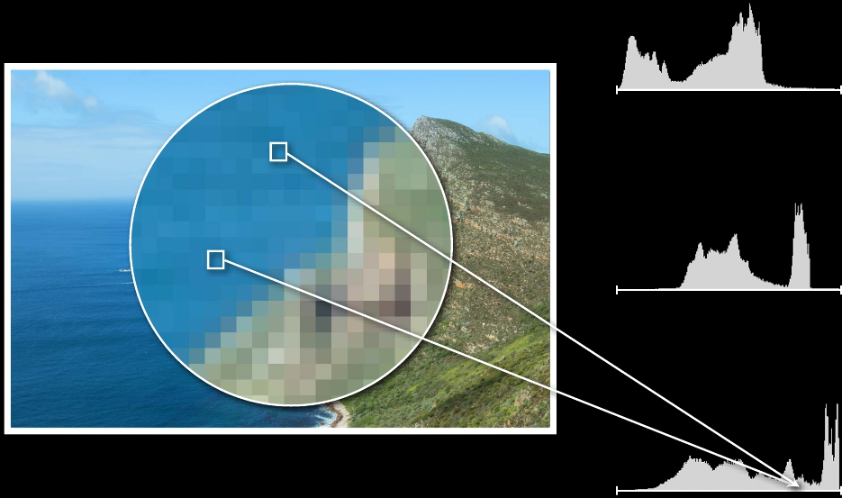
0
255
Red Histogram
0
255
Green Histogram
0
255
Blue Histogram
Notes:
Depending on how we handle things, we may need to make tradeoffs between speed and processing overhead.

Slide 38
0
255
Red Histogram
0
255
Green Histogram
+1
+1
0
255
Blue Histogram
Notes:
For example how do we handle multiple points with the same colour, or collisions.

Slide 39
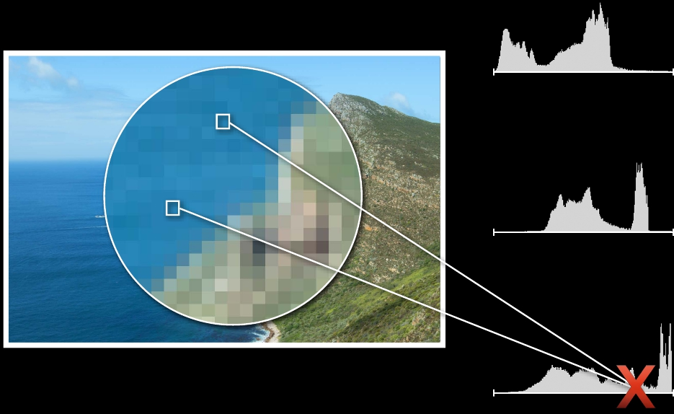
0
255
Red Histogram
0
255
Green Histogram
+1
+1
0
255
Blue Histogram
Notes:
Depending on the application, lots of collisions can lead to overhead in image processing, or not give us the result we want, consuming additional resources, or wasting time. Especially when we are processing the entire picture each time, we need to load it into memory to process. We may only be interested in a particular pattern, but we need to process the entire picture. Some times this might be of benefit, for example compression. We can even discard values within a range like with lossy compression.

Slide 40
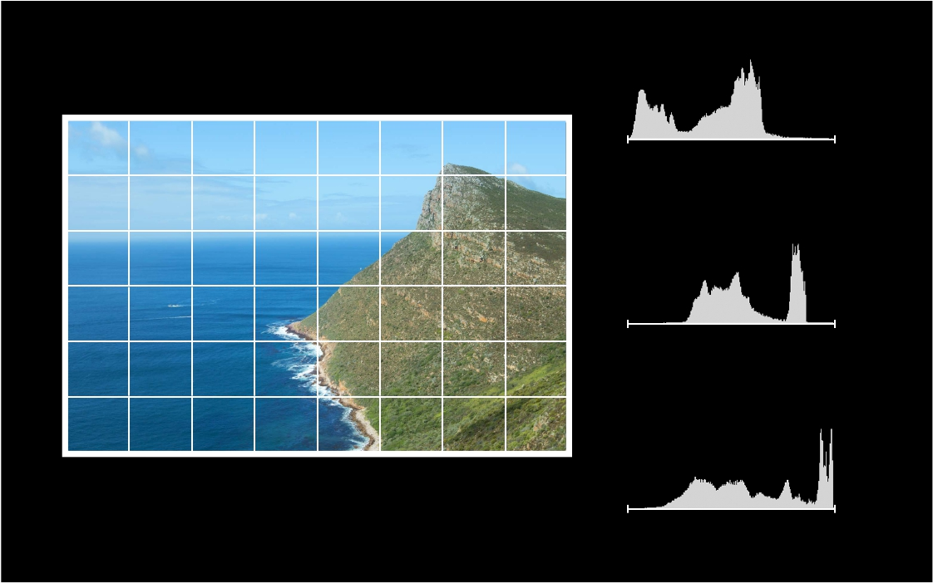
0
255
Red Histogram
0
255
Green Histogram
0
255
Blue Histogram
Notes:
We can speed this process up by splitting the diagram into blocks and use OpenCL capable devices. This can also reduce the number of collisions and improved processing, or localise the effects of collisions so they can be handled easier. Obviously this is a simple example and we could achieve the same results using methods like MPI. However in the case of a single system or a normal size image, the latency of MPI would not be available or slow down the process. Being able to offload the compute work locally would also leave the CPU free to do more complex or generic tasks.

Slide 41
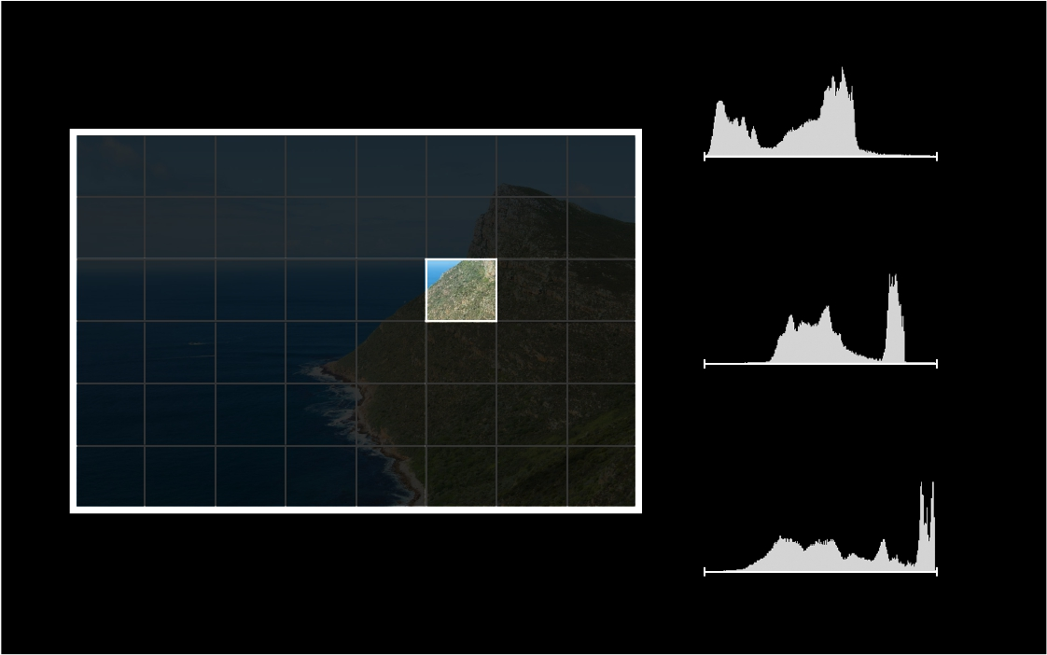
0
255
Red Histogram
0
255
Green Histogram
0
255
Blue Histogram

Slide 42
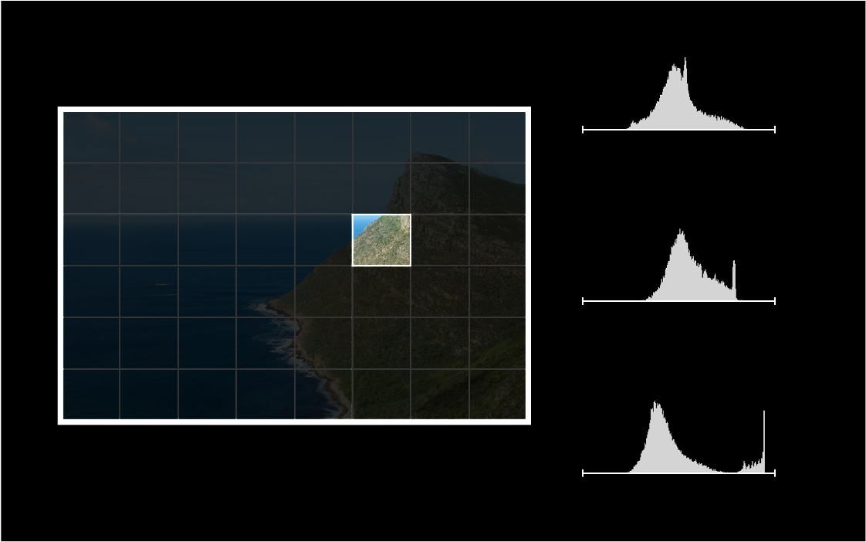
0
255
Partial Red Histogram
0
255
Partial Green Histogram
0
255
Partial Blue Histogram

Slide 43
0
255
Partial Red Histogram
0
255
Partial Green Histogram
Collisions still exist, but only within a group
0
255
Partial Blue Histogram

Slide 44
0
255
Partial Red Histogram
0
255
Partial Green Histogram
Collisions still exist, but only within a group
All groups run in parallel
0
255
Partial Blue Histogram

Slide 45
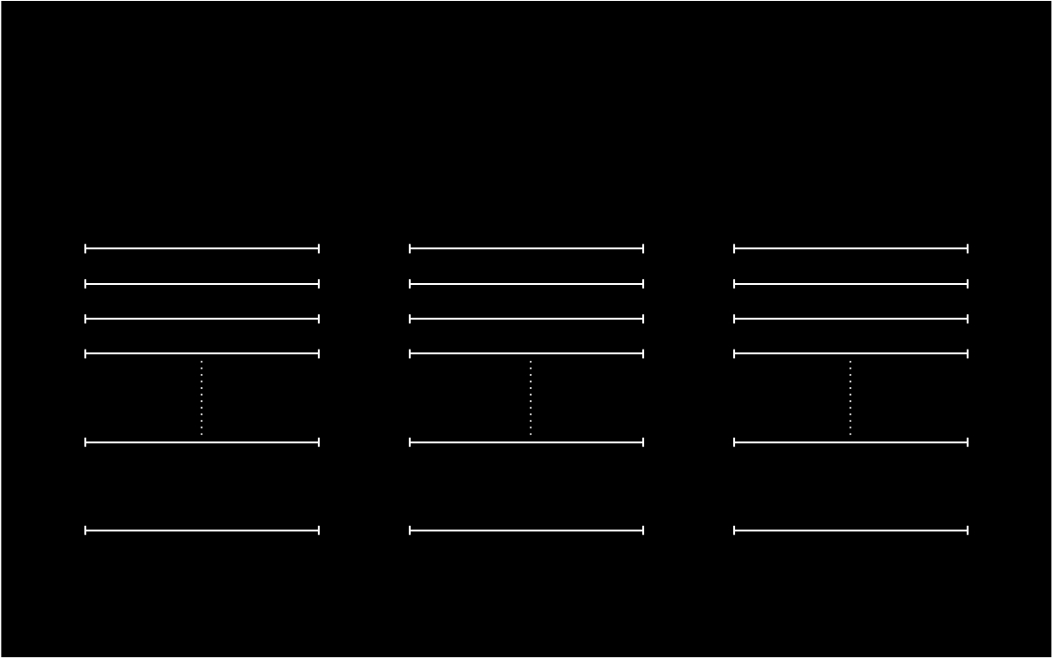
Partial Red Histograms
Partial Green Histograms
Partial Blue Histograms
Total Red Histogram
Total Green Histogram
Total Blue Histogram

Slide 46
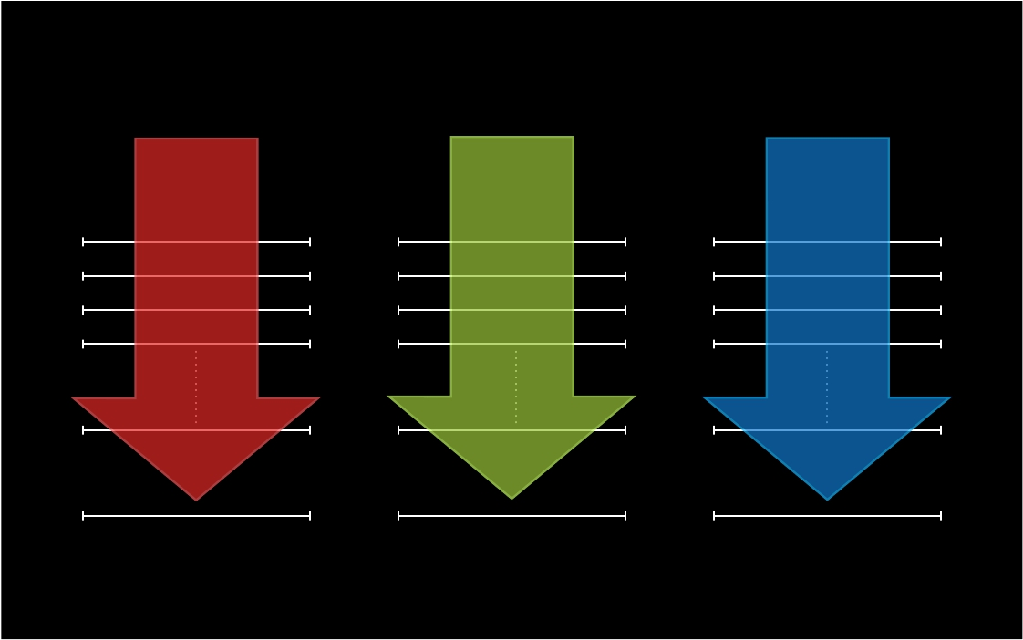
Partial Red Histograms
Partial Green Histograms
Partial Blue Histograms
Total Red Histogram
Total Green Histogram
Total Blue Histogram
Notes:
Using this approach we can build a complete histogram from the partial histograms using parallel processing to speed up this process.

Slide 47
Am I waiting for something?
Have I avoided something intensive?
Do I have a parallel workload?
Can I earn a parallel workload?

Slide 48


Am I waiting for something?
Have I avoided something intensive?
Do I have a parallel workload?
Can I earn a parallel workload?

Slide 49

Am I waiting for something?
Have I avoided something intensive?
Do I have a parallel workload?
Can I earn a parallel workload?
Notes:
From this simple example we can see that we can make use of OpenCL to speed up and improve processing by the application of parallelism. We can also earn ourselves a parallel workload by looking at how we process our data.

Slide 50


Am I waiting for something?
Have I avoided something intensive?
Do I have a parallel workload?
Can I earn a parallel workload?
or
?
Notes:
So when should we use CPU and when should we use GPU?

Slide 51




Am I waiting for something?
Have I avoided something intensive?
Do I have a parallel workload?
Can I earn a parallel workload?
Where is my data now?
Where is my data destined?
How hard am I working?
or
?
Notes:
There’s a few things we take into account or consider in order to make the decision to use CPU or GPU easier. In the following slides we’ll look at processing on the CPU and GPU and things we need to consider.

Slide 52

Host
Notes:
Traditionally we’d just process things on the CPU.

Slide 53
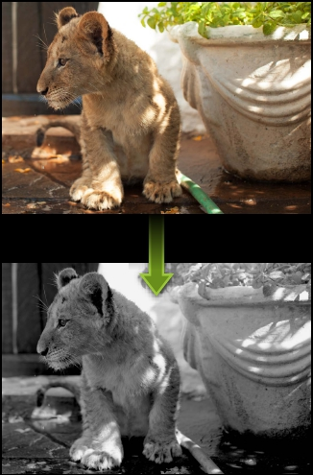
Host
Notes:
We’d load the image into memory and process it.

Slide 54
Host
Total time = compute
Notes:
Generally the bus between memory and CPU was fast in comparison to other busses within the system, so the total time can be considered to be the compute time.

Slide 55
Host
OpenCL Device
Notes:
Now we have OpenCL devices we can utilise for certain workloads.

Slide 56


Host
OpenCL Device
Notes:
Generally we’ll need to load the image into memory and then transfer it to the OpenCL device. Depending on the bus between the CPU and GPU this may take additional time.

Slide 57
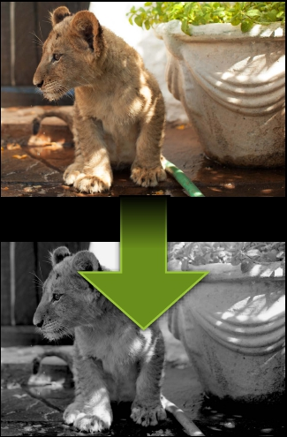
Host
OpenCL Device
Notes:
Once it’s in the OpenCL device it can be processed, much like it was on the CPU. However by using the GPU we may gain access to specific functions that speed up the processing of images, such as matrices or transform operations.

Slide 58
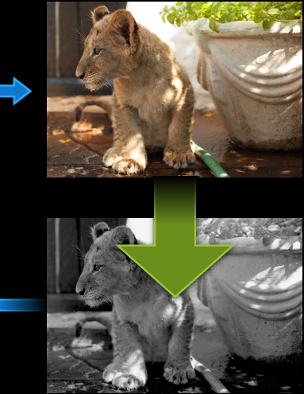
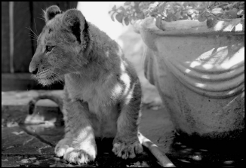
Host
OpenCL Device
Notes:
Once this is complete it will need to be transferred back to the CPU for presentation.

Slide 59
Host
OpenCL Device
Total time = compute
Notes:
The total time isn’t just the compute any longer, we’ve had to transfer the image to and from main memory to GPU.

Slide 60
Host
OpenCL Device
Total time = compute + transfer time
Notes:
Therefore the total time is the compute time plus the transfer time.

Slide 61

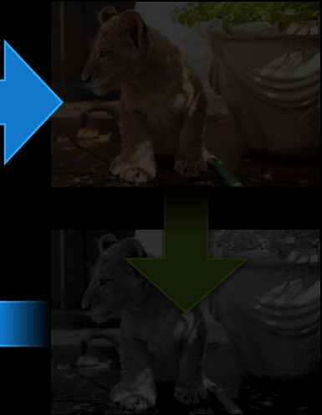

Host
OpenCL Device
Total time = compute + transfer time
Notes:
Let’s have a quick review of some of the things that effect processing time.

Slide 62
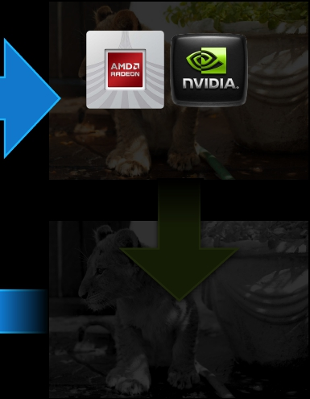
Host
OpenCL Device
Discrete
GPU
PCIe bus speed
Total time = compute + transfer time
Notes:
Offloading the processing to GPU has some overhead as we need to transfer the data across system busses

Slide 63
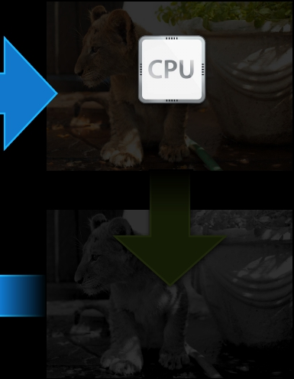
Host
OpenCL Device
Nothing!
Total time = compute + transfer time
Notes:
For the CPU this is close to main memory so not substantiial

Slide 64
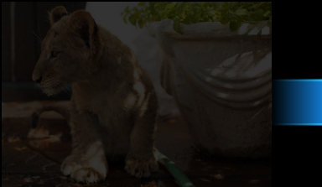
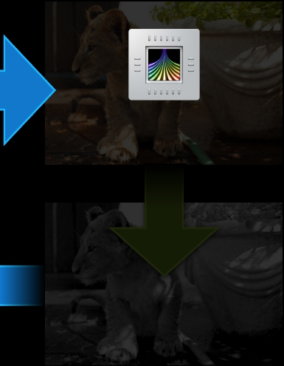

Host
OpenCL Device
Integrated
GPU
Also Nothing!
Total time = compute + transfer time
Notes:
For an integrated GPU this can be less than going to a dedicated GPU.

Slide 65
Host
OpenCL Device
Integrated
GPU
Also Nothing!
(maybe)
Total time = compute + transfer time
Notes:
But we don’t get the full set of instructions we’d get with a discrete GPU. So we need to be aware of diferent workloads and which environments they are best suited to.

Slide 66
Host
OpenCL Device
Notes:
Lets do a side by side comparison.

Slide 67
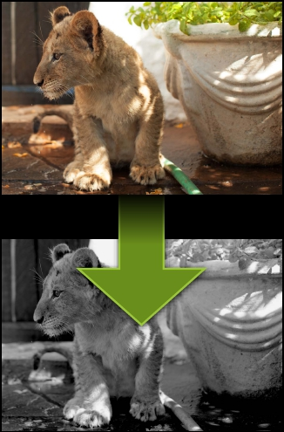

Host
OpenCL Device
Notes:
If we then chose functions which are suited to GPUs.

Slide 68
Host
OpenCL Device
OpenCL is going to win
Notes:
OpenCL is going to be the fastest.

Slide 69
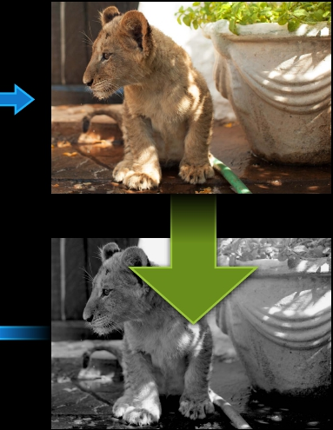
Host
OpenCL Device
Notes:
However if we need to transfer data to and from the GPU, the case for using OpenCL may not be so clear.

Slide 70
Host
OpenCL Device
Ideal discrete GPU scenario
Notes:
The ideal discrete GPU scenario is one where where there is a high level of parallelism and where we don’t need to transfer a lot of data across the bus.

Slide 71

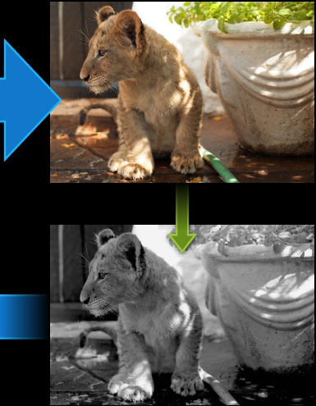
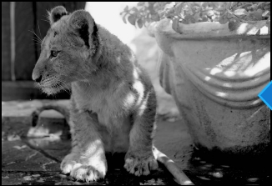
Host
OpenCL Device
Ideal CPU or integrated GPU scenario
Notes:
Where we need to transfer a lot of data across the bus it is best suited to local CPU or integrated GPU.

Slide 72

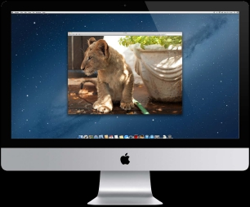
Display Device
OpenCL Device
Notes:
Another thing to consider is the visualisation aspect. Humans are visual creatures, so after crunching data on an OpenCL device you may need to covert it back into a visual display in order for humans to interpret the results.

Slide 73
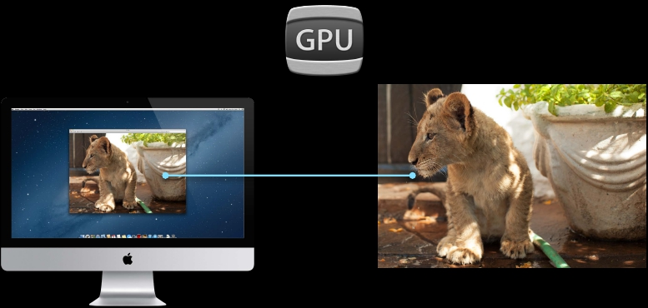
Display Device
OpenCL Device
Notes:
The GPU device used for computation may also be the device used for visualisation.

Slide 74
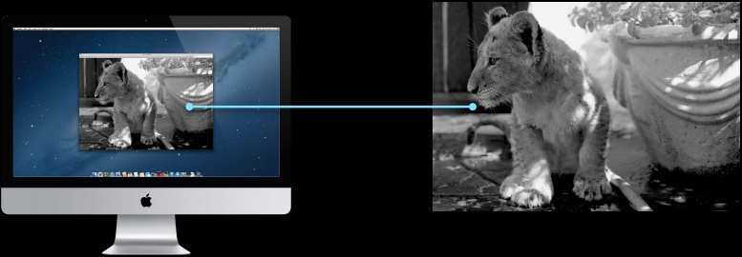
Display Device
OpenCL Device
Notes:
Even though the OpenCL device may well be the same GPU as used for displaying the results visually there is still work to convert that data back into a humanly viewable format.

Slide 75
Display Device
OpenCL Device
Notes:
We may need to visualise both the initial image and the resulting image.

Slide 76
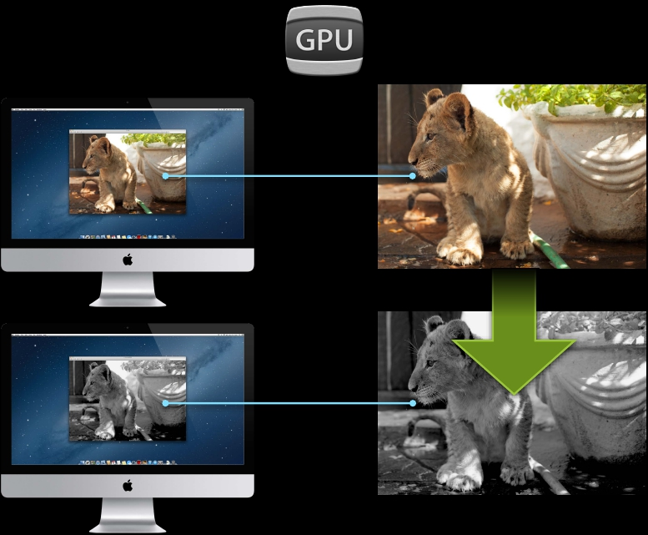
Display Device
OpenCL Device
Notes:
As previously stated this may well be the same device.

Slide 77
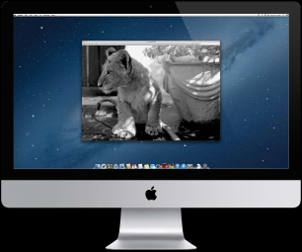
Host
OpenCL Device

Slide 78
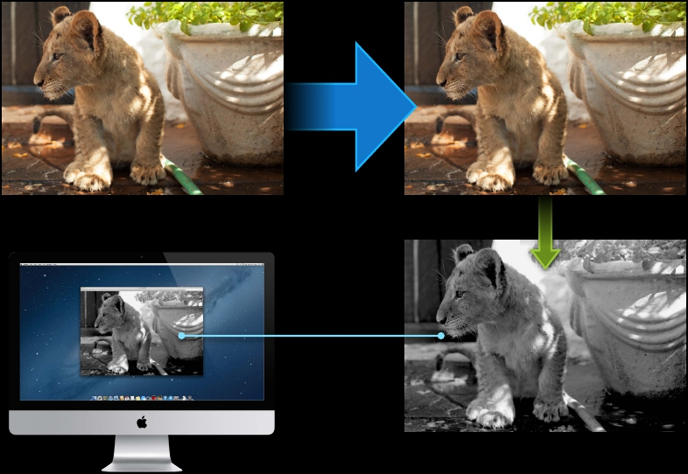
Host
OpenCL Device
Notes:
There is overhead in doing this, and we may need to consider whether this overhead is delaying results. If we are happy to wait for full results that’s fine. We may alternatively chose to use an integrated GPU rather than a discrete GPU if we can get away with it.

Slide 79
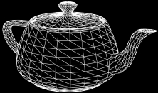
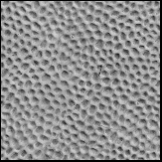
Data on the Device
OpenGL objects
Vertex Buffer Objects
Textures
Notes:
As we’ll see in the next few slides we can also use OpenCL in co-operation with OpenGL. OpenGL is traditionally used for buffer objects and textures.

Slide 80
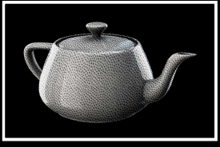
Data on the Device
OpenGL objects
Vertex Buffer Objects
Texture or renderbuffer FBO attachments
Textures
Notes:
These objects are used to create frame buffer objects.

Slide 81
Data on the Device
OpenGL objects
Shaders:Vertex,Tessellation, Geometry, Fragment
Vertex Buffer Objects
Texture or renderbuffer FBO attachments
Textures
Notes:
There are numerous functions we can perform on the objects.

Slide 82
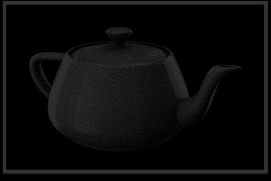

Data on the Device
OpenGL buffer objects = OpenCL buffers
Shaders:Vertex,Tessellation, Geometry, Fragment
Vertex Buffer Objects
Texture or renderbuffer FBO attachments
Textures
Notes:
OpenGL buffers are analogous to OpenCL buffers.

Slide 83

Data on the Device
OpenGL textures, Renderbuffers = OpenCL images
Shaders:Vertex,Tessellation, Geometry, Fragment
Vertex Buffer Objects
Texture or renderbuffer FBO attachments
Textures
Notes:
OpenGL textures and render buffers are analogous to Open CL images.

Slide 84
Data on the Device
OpenCL joins the party
Shaders:Vertex,Tessellation, Geometry, Fragment
Modify or
Generate
Vertex
Data
Post
Process
Images
Vertex Buffer Objects
Texture or renderbuffer FBO attachments
Textures
Notes:
Therefore we can use OpenCL to image processing in co-ordination for OpenGL to speed up operations.

Slide 85

Am I waiting for something?
Have I avoided something intensive?
Do I have a parallel workload?
Can I earn a parallel workload?
Where is my data now?
Where is my data destined?
How hard am I working?
Notes:
So in summary these are the things we need to consider when we are looking to utilise OpenCL.

Slide 86
Development Tasks:
Determine what you want to parallelize
Write your kernels and auxiliary OpenCL routines
Set up the context
Write code to compile and build your OpenCL program
Notes:
Determine what you want to parallelize
Write your kernels and auxiliary OpenCL routines
Set up the context
Write code to compile and build your OpenCL program

Slide 87
Development Tasks:
Enqueue commands to the command queues to control the sequence and synchronization of kernel execution, reading and writing of data, and manipulation of memory objects
Enqueue commands to read the output of the work-items into host memory
Notes:
Enqueue commands to the command queues to control the sequence and synchronization of kernel execution, reading and writing of data, and manipulation of memory objects
Enqueue commands to read the output of the work-items into host memory

Slide 88
Programming Steps
Notes:
Every application that uses OpenCL has to go through a pre-defined series of steps in order to efficiently offload computation to an OpenCL device
Keep in mind for optimal operation and parallelism:
Data versus Task Parallelism
Memory location (and operations) and effect on parallelism
Data size and memory size for optimal processing and latency overhead between devices compared to within devices
How commands should be queued
Type of device and capabilities

Slide 89
Programming Steps
!
Work dispatch
3
Context creation
1
2
GPU identification
4
Get results
Notes:
A kernel function is declared with the __kernel keyword
Before you enqueue a kernel for execution, you call the clSetKernelArg function to pass values to the kernel’s parameters (when you call that function, you identify each parameter by the order in which it’s declared in the kernel definition, starting with 0 for the first parameter)
get_global_id and get_local_size are work-item functions you can use to get information about a work-item while it’s executing.
mul24 is a built-in math function; it multiplies two 24-bit integer values (the OpenCL-C language includes dozens of high-performance built-in math functions for scalar and vector types)
This call and the following three function calls are to auxiliary routines, also written in OpenCL-C, that are defined in the OpenCL program and that can therefore be called by any of the kernel functions

Slide 90
Programming Steps
!
Work dispatch
3
Context creation
1
2
GPU identification
4
Get results

Slide 91
Programming Steps
!
Work dispatch
3
Context creation
1
2
GPU identification
4
Get results
Terminology

Slide 92
Context Creation
cl_device_id
cl_context
cl_command_queue
Notes:
Every OpenCL program requires an OpenCL context, including a list of the OpenCL devices available on the system
Use the clGetDeviceIDs function to query OpenCL for a list of devices on the machine that support OpenCL
You can restrict your search to a particular type of device or to any combination of device types
You must also specify the maximum number of device IDs that you want returned
If you pass CL_DEVICE_TYPE_GPU as the device_type parameter for clGetDeviceIDs and 1 for the num_entries parameter, OpenCL returns an ID for the first OpenCL GPU on that machine that it finds
Once you have determined the available OpenCL devices on the machine and have obtained at least one valid device ID, you are ready to create an OpenCL context
The context serves to group devices together to enable sharing of memory objects across different compute devices

Slide 93
Context Creation
cl_device_id
cl_context
cl_command_queue
Renderer

Slide 94
Context Creation
cl_device_id
cl_context
cl_command_queue
Renderer
Share group
Notes:
After creating your OpenCL context, you must create a command queue
You can specify that profiling be enabled to measure execution time of commands (specify 0 if you don’t want to use this option)
The command queue issues commands to a specific compute device, and ensures that a set of operations occur in a particular order (by enqueuing commands, you request that the device execute your operations in the order that you enqueue them)
As long as your command queues do not issue commands involving the same objects, you do not have to worry about synchronization
You are responsible for synchronizing any necessary order of execution
The OpenCL API includes synchronization commands for this purpose (note that a command is not independent if it writes a memory object read by another command)
If you have multiple OpenCL devices (such as a CPU and a GPU), you must create a command queue for each and you have to divide up the work and submit commands separately to each

Slide 95
Programming Steps
!
Work dispatch
3
Context creation
1
2
GPU identification
4
Get results
Terminology

Slide 96
Programming Steps
!
Work dispatch
3
Context creation
1
2
GPU identification
4
Get results
Terminology

Slide 97
Programming Steps
!
Work dispatch
3
Context creation
1
2
GPU identification
4
Get results
Terminology
API

Slide 98
Context Creation
// Create a context with all GPUs
cl_context c = clCreateContextWithType(NULL,CL_DEVICE_TYPE_GPU,NULL,NULL,NULL);

Slide 99
Programming Steps
!
Work dispatch
3
Context creation
1
2
GPU identification
4
Get results

Slide 100
Programming Steps
!
Work dispatch
3
Context creation
1
2
GPU identification
4
Get results

Slide 101
GPU Identification
Renderer ID to cl_device_id
The cl_device_id is a static global value, not a context property
!
cl_device_id secondaryCLDeviceId =
CGLGetDeviceFromGLRenderer(secondaryGPURendererID);
!
cl_command_queue q = clCreateCommandQueue(c,secondaryCLDeviceId,0,NULL);

Slide 102
Programming Steps
!
Work dispatch
3
Context creation
1
2
GPU identification
4
Get results

Slide 103
Programming Steps
!
Work dispatch
3
Context creation
1
2
GPU identification
4
Get results

Slide 104
Work Dispatch
OpenCL
cl_command_queue q = clCreateCommandQueue(c,secondaryCLDeviceId,0,NULL);
!
clSetKernelArg(k,0,…);
clSetKernelArg(k,1,…);
clEnqueueNDRangeKernel(q,k,…);

Slide 105
Programming Steps
!
Work dispatch
3
Context creation
1
2
GPU identification
4
Get results

Slide 106
Programming Steps
!
Work dispatch
3
Context creation
1
2
GPU identification
4
Get results

Slide 107
Get Results
Switching GPUs

Slide 108
Get Results
Switching GPUs
cl_command_queue primary_q = …
cl_command_queue secondary_q = …

Slide 109
Get Results
Switching GPUs
cl_command_queue primary_q = …
cl_command_queue secondary_q = …
clEnqueueNDRangeKernel(primary_q, k0, … );

Slide 110
Get Results
Switching GPUs
cl_command_queue primary_q = …
cl_command_queue secondary_q = …
clEnqueueNDRangeKernel(primary_q, k0, … );
clFlush(primary_q);

Slide 111
Get Results
Flush and bind

Slide 112
Get Results
Flush and bind
clEnqueueNDRangeKernel(secondary_q, k0, … );

Slide 113
Get Results
Flush and bind
clEnqueueNDRangeKernel(secondary_q, k0, … );
clFlush(primary_q);
…

Slide 114
Offline Tasks

Slide 115
Offline Tasks
Apply the operation once

Slide 116
Offline Tasks
Apply the operation once
Takes longer than a frame

Slide 117
Offline Tasks
Apply the operation once
Takes longer than a frame
Results saved to main memory or disk

Slide 118
Offline Tasks
Apply the operation once
Takes longer than a frame
Results saved to main memory or disk
Could be done off the main thread

Slide 119
Get Results
Flush and bind
clEnqueueNDRangeKernel(secondary_q, k0, … );
clFlush(primary_q);
…
CGLSetVirtualScreen(secondary);
…
glBindBuffer(…);
glDrawElements(…);
…

Slide 120
Design Challenge
Have to divide the work
Display connected to primary GPU only

Slide 121
Handling Other Multi-GPU Situations
Laptop with automatic graphics switching
Multiple displays connected to multiple GPUs

Slide 122
The OpenCL Programming Model
OpenCL supports data parallel and task parallel programming models
Every application that uses OpenCL has to go through a pre-defined series of steps in order to efficiently offload computation to an OpenCL device
Notes:
OpenCL supports data parallel and task parallel programming models:
As used in OpenCL, data parallel processing refers to many instances of the same kernel being executed simultaneously, with each instance operating on its own set of data (each set of data is associated with a point in a 1-, 2-, or 3-dimensional index space)
Task parallel programming is similar to the familiar process of spawning multiple threads, each performing different tasks. In OpenCL terms, task-parallel programming involves enqueuing many kernels, and letting OpenCL run them in parallel using available processors
Every application that uses OpenCL has to go through a pre-defined series of steps in order to efficiently offload computation to an OpenCL device
Keep in mind for optimal operation and parallelism:
Data versus Task Parallelism
Memory location (and operations) and effect on parallelism
Data size and memory size for optimal processing and latency overhead between devices compared to within devices
How commands should be queued
Type of device and capabilities

Slide 123
The OpenCL Programming Model
C-like Programming
Language
Runtime API

Slide 124
The OpenCL Programming Model
C-like Programming
Language
Runtime API

Slide 125
The OpenCL Programming Model
C-like Programming
Language
Describe your work from the
perspective of one piece of data
Runtime API

Slide 126
The OpenCL Programming Model
C-like Programming
Language
Describe your work from the
perspective of one piece of data
Guts of your loop
Runtime API

Slide 127
// Converting a 1920x1080 image from RGBA to HSV
// rgb is uint32_t* 1 uint32_t per RGBA 8-bit pixel
// hsv is float* 4 floats per pixel
for (y = 0; y < 1080; y++) {
for (x = 0; x < 1920; x++) {
int index = y * 1920 + x; //
int r = rgb[index] & 0x000000FF; //
int g = rgb[index] & 0x0000FF00 >> 8; //
int b = rgb[index] & 0x00FF0000 >> 16; //
int a = rgb[index] & 0xFF000000 >> 24; //
float rf = (float)r / 255.0f; //
float gf = (float)g / 255.0f; //
float bf = (float)b / 255.0f; //
locate
extract
extract
extract
extract
convert
convert
convert
R
G
B
A
R
G
B
float h, s, v;
rgb2hsv(rf, gf, bg, &h, &s, &v);
// RGB to HSV
hsv[index*4+0]
hsv[index*4+1]
hsv[index*4+2]
hsv[index*4+3]
=
=
=
=
h;
s;
v;
a / 255.0f;
// write
// results
}
}

Slide 128
void rgb2hsv(float r, float g, float b, float *h, float *s, float *v) {
float cmax = r > g ? r : g; cmax = cmax > b ? cmax : b;
float cmin = r < g ? r : g; cmin = cmin < b ? cmin : b;
float delta = max - min;
*v = cmax;
if ( cmax == 0.0f || delta == 0.0f ) {
*h = *s = 0.0f;
return;
}
if (
*h
else
*h
else
*h
r == cmax )
= (g - b) / delta;
if ( g == cmax )
= 2 + (b - r) / delta;
= 4 + (r - g) / delta;
*h *= 60;
if ( *h < 0.0f ) *h += 360.0f;
*s = delta / cmax;
}

Slide 129
kernel void convert_rgb2hsv(read_only image2d_t in, write_only image2d_t out)
{
size_t x = get_global_id(0); // locate my pixel
size_t y = get_global_id(1);
float4 pixel = read_imagef(in, (int2)(x,y));
float4 result = rgb2hsv(pixel);
write_imagef(out, (int2)(x,y), result);
// read
// RGB to HSV
// write
}

Slide 130
The OpenCL Programming Model
C-like Programming
Language
Describe your work from the
perspective of one piece of data
Guts of your loop
Runtime API

Slide 131
The OpenCL Programming Model
C-like Programming
Language
Runtime API

Slide 132
The OpenCL Programming Model
C-like Programming
Language
Runtime API
Discovery
Setup
Execution

Slide 133
The OpenCL Programming Model
C-like Programming
Language
What devices are in my Machine?
Given a device, what’s the best way
to break up my work?
Runtime API
Discovery
Setup
Execution

Slide 134
The OpenCL Programming Model
C-like Programming
Language
Compile kernels
Set aside memory
Runtime API
Discovery
Setup
Execution

Slide 135
The OpenCL Programming Model
C-like Programming
Language
Runtime API
Discovery
Setup
Execution
Send commands to the device
Run the kernel!

Slide 136
Buffers vs.Images
•Buffer objects
■
Read/write from a kernel using pointers
■Support atomic operations
■May or may not be cached
•Image objects
■Either read-only or write-only from a kernel
■Hardware filtering
■GPU texture cache, low latency

Slide 137
Sometimes You Might Want Both
kernel void histogramGather(..., global float* histo) {
...
histo[index] = count;
...
}
kernel void equalization(..., read_only image2d_t histo) {
...
float interpolated = read_imagef(histo, CLK_FILTER_LINEAR|...).r;
...
}

Slide 138
image2d from Buffer
•cl_khr_image2d_from_buffer
•Sampling modes and capabilities of an ordinary image2d
cl_image_format fmt = { CL_RGBA, CL_FLOAT };
size_t pixel = 16;
cl_mem_flags flags = CL_MEM_READ_WRITE;
cl_mem buffer_mem = clCreateBuffer(c,flags,w*h*pixel,NULL,&err);
cl_image_desc desc = {
.image_type = CL_MEM_OBJECT_TYPE_IMAGE2D,
.image_width = w,
.image_height = h,
.image_row_pitch = pitch,
...
.buffer = buffer_mem,
};
cl_mem img = clCreateImage(c,flags,&fmt,&desc,NULL,&err);

Slide 139
image2d from Buffer Alignment
•CL_DEVICE_IMAGE_BASE_ADDRESS_ALIGNMENT
■
For CL_MEM_USE_HOST_PTR buffers
•CL_DEVICE_IMAGE_PITCH_ALIGNMENT
cl_image_desc desc = {
.image_type = CL_MEM_OBJECT_TYPE_IMAGE2D,
.image_width = w,
.image_height = h,
.image_row_pitch = pitch,
...
.buffer = buffer_mem,
};

Slide 140
Data Movement in Compute Apps
Many apps write/execute/read
2ms
Write Data
clEnqueueWriteBuffer
6ms
Execute Kernel
clEnqueueNDRangeKernel
2ms
Read Data
clEnqueueReadBuffer

Slide 141
iteration n:10ms
Execute Kernel
n
Write Data
n
Read Data
n

Slide 142
iteration n:10ms
Kernel
Read Data
n-1
Write Data
n
Execute Kernel
n
Read Data
n
Write Data
n+1
Execute Kernel
n+1
Read Data
n+1
100 iterations in 1000 ms

Slide 143
Overlapping Read/Write and Compute
Using DMA hardware
100 iterations in 604 ms
Write Data
0
...
Write Data
n+1
Read Data
n-1
Write Data
n+2
Read Data
n
Write Data
n+3
Read Data
n+1
...
Read Data
100
Execute Kernel
n
Execute Kernel
n+1
Execute Kernel
n+2

Slide 144
Overlapping Read/Write and Compute
For M input and output buffers
clEnqueueWriteBuffer(q,data[0],CL_FALSE,...);
clSetKernelArg(k,0,sizeof(cl_mem),&data[0]);
clEnqueueNDRangeKernel(q,k,...);
for (int i=1;i!=M-1;++i) {
clEnqueueWriteBuffer(q,data[(i+1)],CL_FALSE,...);
clSetKernelArg(k,0,sizeof(cl_mem),&data[i]);
clEnqueueNDRangeKernel(q,k,...);
clEnqueueReadBuffer(q,data[(i-1)],CL_FALSE,...);
}
clSetKernelArg(k,0,sizeof(cl_mem),&data[(M-1)]);
clEnqueueNDRangeKernel(q,k,...);
clEnqueueReadBuffer(q,data[(M-1)],CL_FALSE,...);
clFlush(q);
All enqueued commands
are non-blocking

Slide 145
Programming Tips
•Prefer page aligned pointers for host data
■
CL_MEM_USE_HOST_PTR buffers and images
Source and destination for read and write commands
■

Slide 146
Programming Tips
•Prefer page aligned pointers for host data
■
CL_MEM_USE_HOST_PTR buffers and images
Source and destination for read and write commands
■
cl_float2* host_ptr;
posix_memalign(&host_ptr,PAGE_SIZE,num_bytes);
...
cl_mem m = clCreateBuffer(c,CL_MEM_USE_HOST_PTR,num_bytes,host_ptr,&err);
...
free(host_ptr);

Slide 147
Learning More
OpenCL Programming Book
http://www.fixstars.com/en/opencl/book/OpenCLProgrammingBook/contents/
OpenCL Programming Guide Source on Google Code
https://code.google.com/p/opencl-book-samples/
OpenCL and Xcode
https://developer.apple.com/library/mac/#documentation/Performance/
Conceptual/OpenCL_MacProgGuide/Introduction/Introduction.html

